Slide 1

A Survey of Notification Designs in Commercial mHealth Apps
Julia Woodward¹, Yu-Peng Chen¹, Katarina Jurczyk¹, Kathryn M. Ross², Lisa Anthony^{1,} Jaime Ruiz¹
¹Dept of CISE, University of Florida, Gainesville FL USA
²Dept of Clinical and Health Psychology, University of Florida, Gainesville FL USA
Notes:
Hello my name is Julia Woodward, I am a PhD Student from the University of Florida, and I am presenting our work on A Survey of Notification Designs in Commercial mHealth Apps

Slide 2
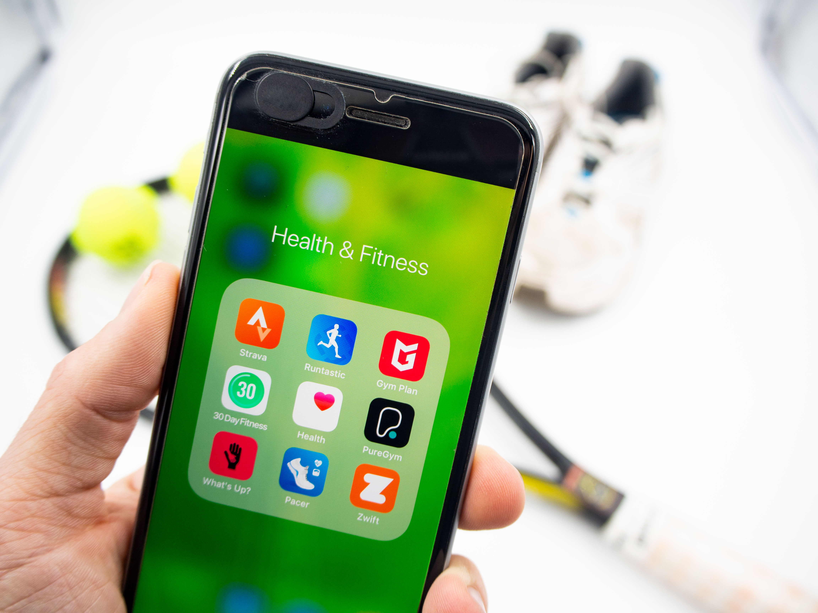
Health and Fitness Apps on Mobile Health by Forth Edge (CC BY 2.0)
Notes:
Mobile Health or mHealth is the use of mobile and wireless technologies to support health objectives. And mHealth apps have been shown to help users achieve their health goals

Slide 3
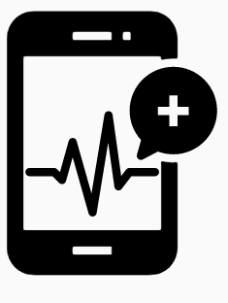
Motivation
mHealth app notifications increase users’ app engagement and adherence (Bidargaddi et al. JMIR mHealth and uHealth 2018)
However, few mHealth apps are grounded in advised health behavior theories or properly evaluated
(Whittaker Journal of Medical Internet Research 2012)
We wanted to examine if there was a gap between existing notification design recommendations and practice
Healthcare Mobile App by Vectors Point, PK (CC BY 3.0)
Notes:
More specifically, mHealth app notifications have been found to help users achieve their health goals through..

Slide 4
Sample of mHealth Apps
Randomly selected 50 apps from database of mHealth apps
(Xu and Liu, JMIR mHealth and uHealth 2015)
Included free apps that had 500+ reviews and 3+ stars
App Themes | Count (n = 50)
Fertility | 9
Weight | 9
Medication | 8
Water | 7
Baby & Pregnancy | 6
Blood Pressure | 4
Workout | 3
Smoking | 2
Health Routine | 1
Vision | 1
Notes:
We first had to select a sample of mHealth apps to survey, we randomly selected…
Apps included a wide range of themes in mHealth, for example

Slide 5
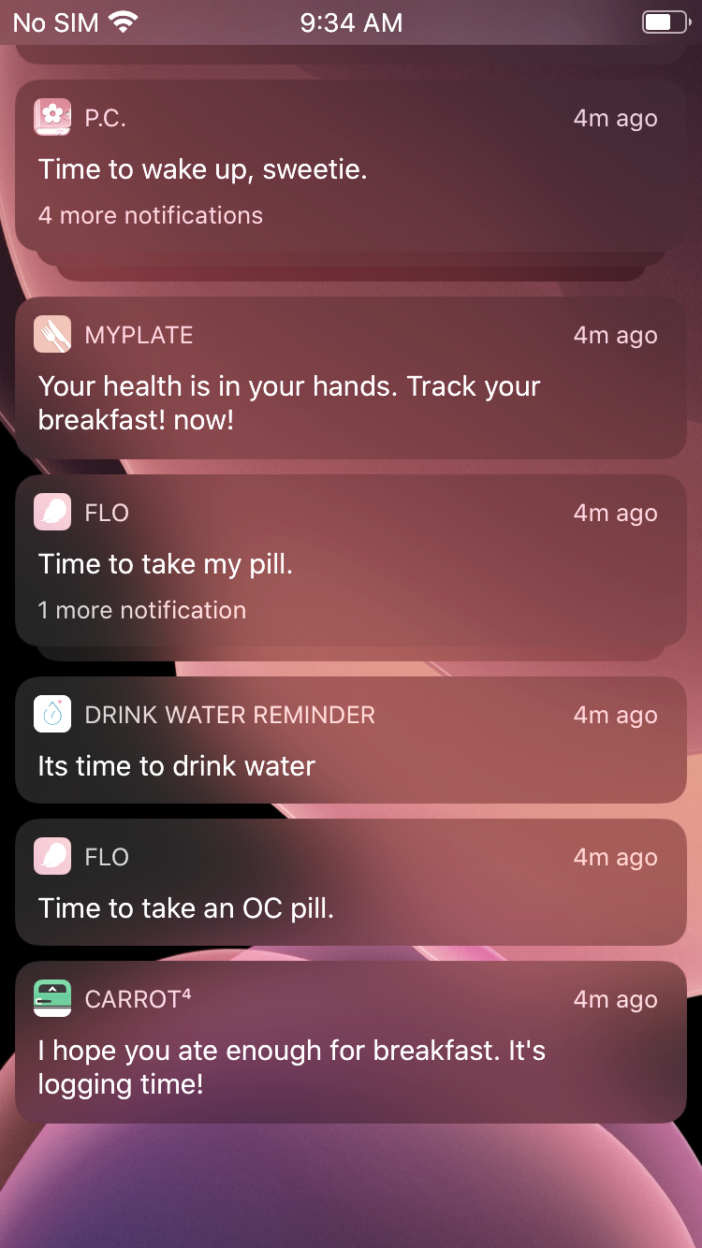
Analysis
Two researchers downloaded and interacted with the 50 apps for 5 consecutive days
Accumulated 1,390 notifications
Transcribed every notification that occurred
Qualitatively coded the notifications based on 13 dimensions
Screenshot of Notification

Slide 6
Dimensions
Notification Dimension Themes:
(Muench and Baumel Journal of Medical Internet Research 2017)
Notification Occurrence
Notification Content
Personalization
Notes:
The 13 dimensions were broken down into three themes

Slide 7
Dimensions
Notification Dimension Themes:
(Muench and Baumel Journal of Medical Internet Research 2017)
Notification Occurrence
Notification Content
Personalization
  Occurrence (what triggered it)
  Frequency (daily, weekly, monthly)
Notes:
Notification Occurrence included the themes occurrence, what triggered it, and the frequency

Slide 8
Dimensions
Notification Dimension Themes:
(Muench and Baumel Journal of Medical Internet Research 2017)
Notification Occurrence
Notification Content
Personalization
  Notification Type (push or inside)
  Content Type (statement, ques, etc.)
  Content Purpose (remind, tips, etc.)
  Goal Type (short- or long-term)
  Interactivity (link, acknowledge, etc.)
  Tailoring (user’s name, data, etc.)
  Aesthetics (images, color, etc.)
  Including Sender (app, human, etc.)
Notes:
Notification Content included the notification type, content type…

Slide 9
Dimensions
Notification Dimension Themes:
(Muench and Baumel Journal of Medical Internet Research 2017)
Notification Occurrence
Notification Content
Personalization
  Notification Settings
  Customizable (time, amount, etc.)
  Creating Notifications (manual or default)
Notes:
And personalization included if the app has notification settings, if the user can customize the notifications, and if the user has to manually create the notifications or if it is default within the app

Slide 10
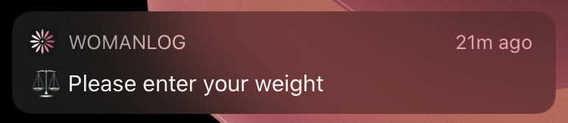
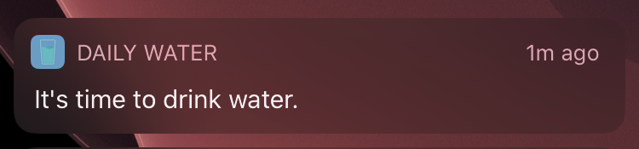
Results: Align
mHealth app notifications align with recommendations on:
  Content type, including statements over questions
  Adding aesthetics (e.g., images, different font sizes)
  Notification settings
  Notification customization (e.g., changing the time, turning on/off)
Aesthetic Image
Screenshots of Notifications
Notes:
We found that mHealth app notifications align with recommendations on….These screenshots show notifications that align with recommendations on including statements and *adding an aesthetic image
***However, we also found a disconnect between current practice and recommendations in several areas

Slide 11
Results: Disconnect
Frequency: Most sent daily (92.45%), but sending more lowers user retention
Content Purpose: Majority were reminders (89.6%), but reminders can hinder habit development
Interactivity: Did not include interactive elements (59.5%), but interactivity increases user engagement
Screenshot of Notifications
Notes:
The areas in which we found a disconnect include frequency, most notifications were sent daily although prior work has showed that sending more can lower user retention.
We also saw a disconnect for content purpose, the majority of the notifications were reminders although this can hinder habit development.
And we found that most of the notifications did not include interactive elements although it can increase user engagement.

Slide 12
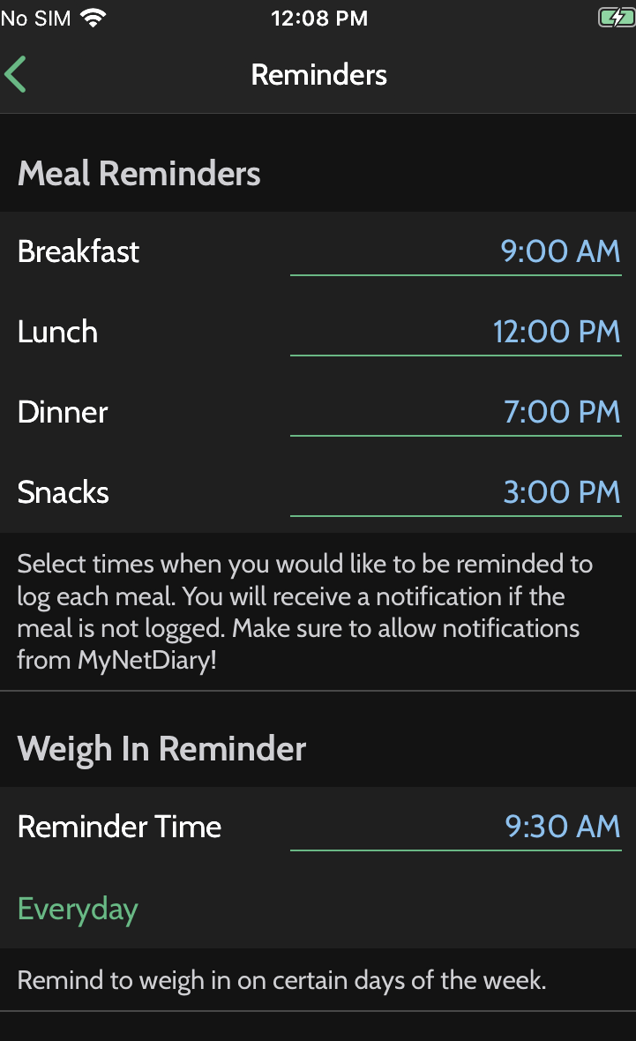
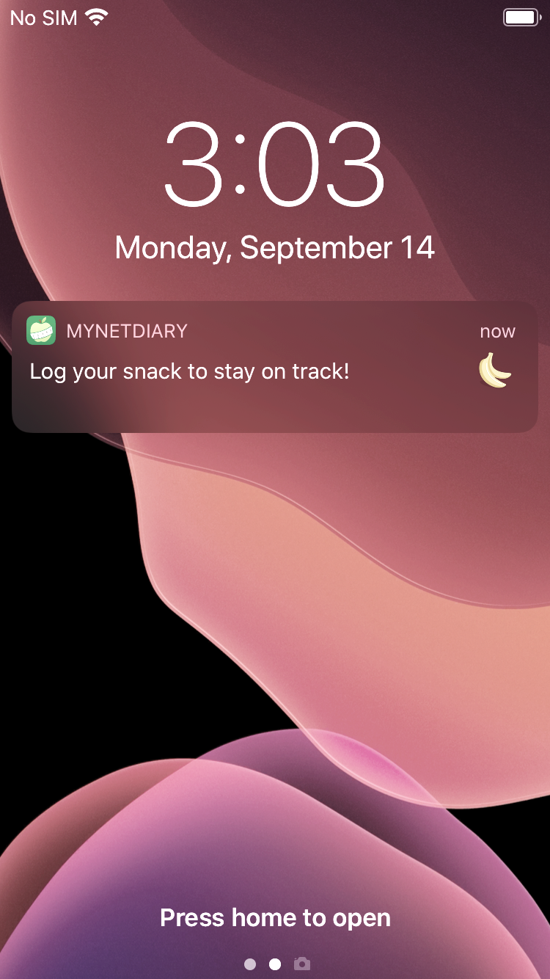
Results: Disconnect
Occurrence: Triggered due to time (84.1%) instead of user’s activities and environment
Sender: Did not explicitly state the sender (83.2%), but including sender increases credibility
Tailoring: Content not tailored to the user (67.4%), but tailoring increases engagement
Notification Settings
Screenshot of Notification
Notes:
We also saw a disconnect for occurrence, most of the notifications were triggered due to time, instead of the user’s activities and environment. In the screenshots to the right the notification was triggered based on the time the user set.
We also saw that most of the notifications did not include a sender although this can increase credibility, and the content was not tailored to the user.

Slide 13
Open Research Questions
Occurrence: What contextual triggers would be effective in increasing engagement and adherence in mHealth apps?
Frequency: How often should notifications be sent to keep users engaged in mHealth? Does it differ based on app theme?
Interactivity: What interactive elements help the most with mHealth app engagement?
Notes:
Based on these findings we identified open research questions, for example

Slide 14
Conclusion
mHealth app notifications help users achieve their health goals, but few mHealth apps are grounded in behavior theories or properly evaluated
We surveyed notifications from 50 mHealth apps
We found a disconnect between current practice and notification design recommendations in several areas
We identified open research questions in the area of mHealth app notifications

Slide 15






Thank you!
https://ruizlab.org
https://init.cise.ufl.edu
Contact Authors
Julia Woodward - julia.woodward@ufl.edu
Dr. Jaime Ruiz – jaime.ruiz@ufl.edu
Julia Woodward
Jaime Ruiz
Yu-Peng Chen
Katarina Jurczyk
Kathryn M. Ross
Lisa Anthony

