Slide 1
Detecting Face Touching with Dynamic Time Warping on Smartwatches: A Preliminary Study
Yu-Peng Chen¹, Chen Bai², Adam Wolach³, Mamoun T. Mardini^{2,3}, Lisa Anthony¹
¹Dept. of CISE, University of Florida, FL USA
²Dept. of Health Outcomes and Biomedical Informatics, College of Medicine, University of Florida, FL USA
³Dept. of Aging and Geriatric Research, College of Medicine, University of Florida, FL USA
Yu-Peng Chen, Chen Bai, Adam Wolach, Mamoun T. Mardini, and Lisa Anthony. 2021. Detecting Face Touching with Dynamic Time Warping on Smartwatches: A Preliminary Study. In Companion Publication of the 2021 International Conference on Multimodal Interaction (ICMI ’21 Companion), October 18–22, 2021, Montréal, QC, Canada. ACM, New York, NY, USA, 8 pages. https://doi.org/10.1145/3461615.3485433
Notes:
Hi everyone, I‘m Yu-Peng Chen, a third-year PhD student at UF
Today I will be talking about TITLE

Slide 2
Motivation
COVID-19 has been a global challenge in many ways¹
CDC: avoid touching eyes, nose, or mouth with unwashed hands ²
People touch their faces 23 times per hour on average ³
Maria Nicola, Zaid Alsafi, Catrin Sohrabi, Ahmed Kerwan, Ahmed Al-Jabir, Christos Iosifidis, Maliha Agha, and Riaz Agha. 2020. The socio-economic implications of the coronavirus pandemic (COVID-19): A review. International journal of surgery (London, England) 78: 185–193. https://doi.org/10.1016/j.ijsu.2020.04.018
Centers for Disease Control and Prevention. 2020. Prevent Getting Sick. Retrieved March 8, 2021 from https://www.cdc.gov/coronavirus/2019-ncov/prevent-getting-sick/index.html
Kwok YL, Gralton J, McLaws ML. Face touching: a frequent habit that has implications for hand hygiene. Am J Infect Control. 2015 Feb;43(2):112-4. doi: 10.1016/j.ajic.2014.10.015. PMID: 25637115; PMCID: PMC7115329.
Notes:
COVID-19 has been a global challenge in many ways. Therefore, it is essential to find solutions to slow the spread of this virus
CDC recommended that we avoid touching our face with unwashed hands to protect ourselves from the virus
However, previous work showed that people touch their face 23 times per hour on average without realizing it.

Slide 3
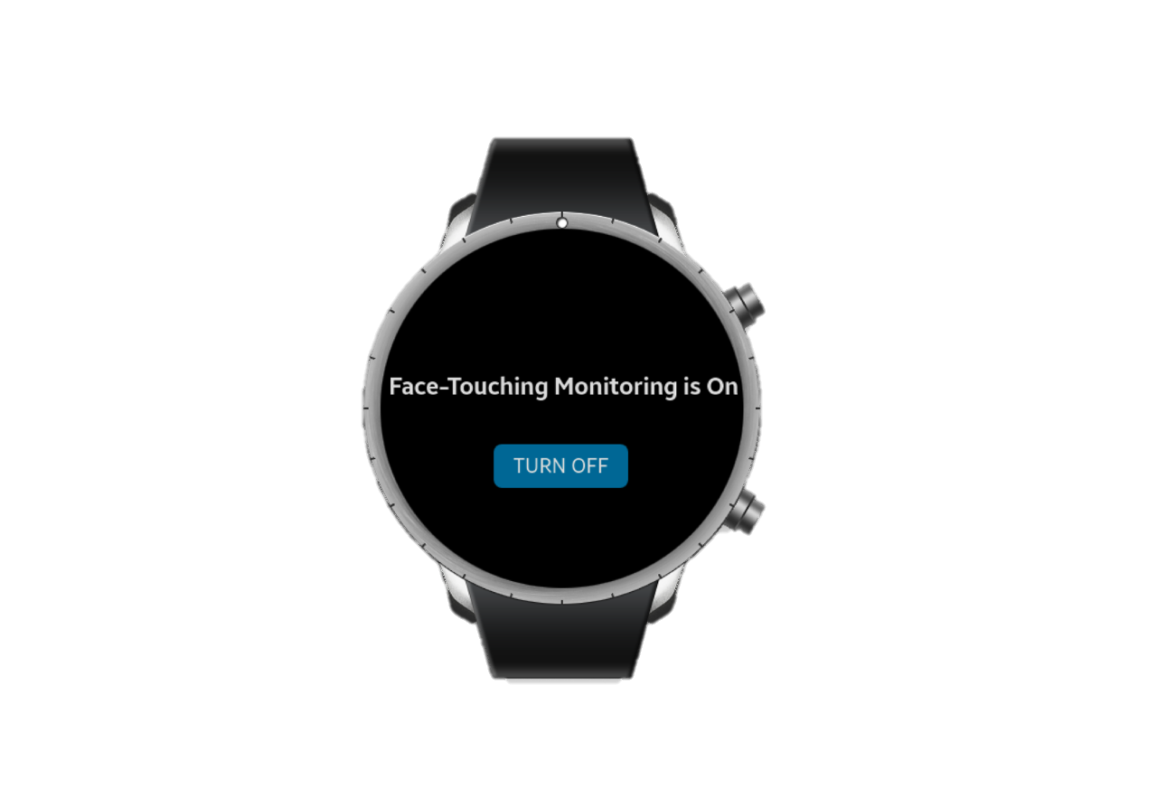
Project Goal
We explore a possible approach to help users avoid touching their face in daily life by alerting them through a smartwatch application every time a face-touching behavior occurs
Notes:
Therefore, our goal is to help users avoid touching their face by detecting their face-touching behaviors and alert them of such behaviors via smartwatches

Slide 4
Smartwatch
Increasing pervasiveness
  Worldwide shipments of wristbands and smartwatches reached more than 170 million units in 2020¹
Computational and sensory capabilities
  Samsung Gear S Smartwatch for accelerometer-based activity recognition²
International Data Corporation. 2021. Consumer Enthusiasm for Wearable Devices Drives the Market to 28.4% Growth in 2020, According to IDC. Retrieved March 22, 2021 from https://www.idc.com/getdoc.jsp?containerId=prUS47534521
Davoudi A, Wanigatunga AA, Kheirkhahan M, et al. Accuracy of Samsung Gear S Smartwatch for Activity Recognition: Validation Study. JMIR Mhealth Uhealth. 2019;7(2):e11270. Published 2019 Feb 6. doi:10.2196/11270
Notes:
One of the reasons for using a smartwatch is its popularity, which provides a scalable platform that can be used by a large share of the population
The other reason is that a smartwatch also has computational and sensory capabilities that are sufficient for achieving our goal
Prior work showed that a smartwatch can be used as an alternative to a research-grade activity monitor for accelerometer-based human activity recognition

Slide 5
Method – Data Collection
10 activities
  6 non-face-touching activities
  4 face-touching activities
10 participants
  Age from 20 to 83 (M = 47.7, SD = 27.7)
  Wore the smartwatch on their dominant wrist
  Performed each activity repeatedly for 3 minutes
A monitoring smartwatch application
  Sampling frequency: 30 Hz
  ~5400 data points
Group | Activity
Non-face-touching | Using a mobile phone
 | Lying flat on the back
 | Computer tasks
 | Writing
 | Leisurely walk
 | Moving items from one location to another
Face-touching | Repeated face touching
 | Eating and drinking
 | Simulated smoking
 | Adjusting eyeglasses
Notes:
To collect data for evaluating our method,
We first selected 10 everyday activities, including 6 non-face-touching activities and 4 face-touching activities
Then, we asked 10 participants, age from 20 to 83, to perform each activity repeatedly for 3 minutes while wearing the smartwatch on their dominant wrist.
We developed a monitoring smartwatch app to collect accelerometer data with 30 Hz sampling frequency

Slide 6
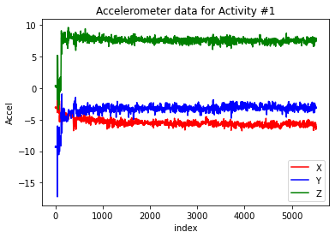
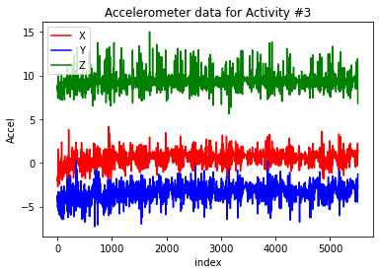
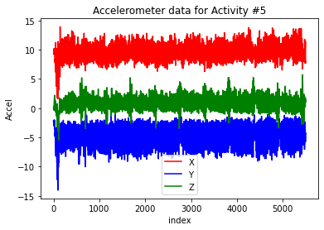
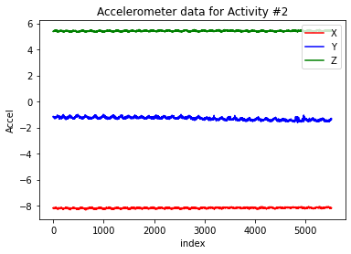
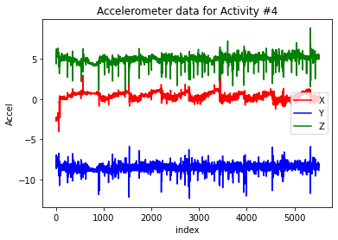
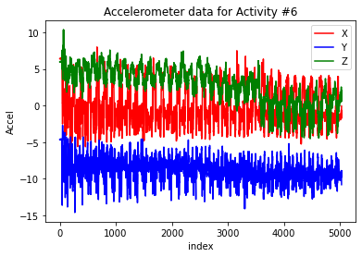
Data Visualization (Non-Face-Touching)
1. Use mobile phone
3. Computer tasks
5. Leisure walk
2. Lying flat
4. Writing
6. Moving items
Notes:
This slide shows the visualization of some sample data streams for each activity [NEXT]

Slide 7
Data Visualization (Non-Face-Touching)
1. Use mobile phone
3. Computer tasks
5. Leisure walk
2. Lying flat
4. Writing
6. Moving items
Notes:
the horizontal-axis is the number of data points [NEXT]

Slide 8
Data Visualization (Non-Face-Touching)
1. Use mobile phone
3. Computer tasks
5. Leisure walk
2. Lying flat
4. Writing
6. Moving items
Notes:
We collected the accelerometer data in the x, y, z directions
So, the vertical-axis is the value of the acceleration along the x, y ,z directions

Slide 9
Data Visualization (Non-Face-Touching)
1. Use mobile phone
3. Computer tasks
5. Leisure walk
2. Lying flat
4. Writing
6. Moving items
Notes:
Red lines are the data in the x direction, blue lines are the data in the y direction, and green lines are the data in the z direction
These are the non-face-touching activities. We can see that there is less oscillation compared to the ones we’ll see in the next slide

Slide 10
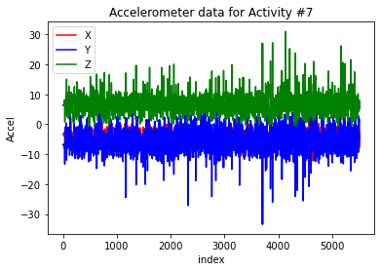
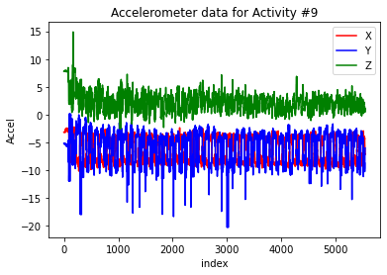
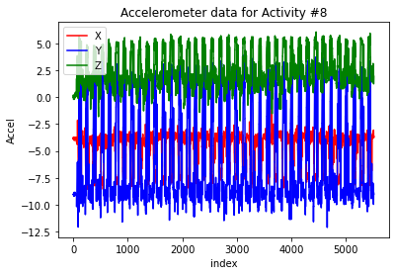
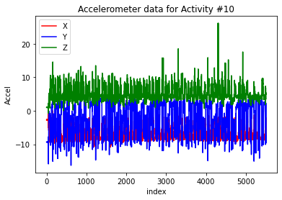
Data Visualization (Face-Touching)
7. Repeated face touching
9. Simulated smoking
8. Eating and drinking
10. Adjusting eyeglasses
Notes:
These are the visualizations of face touching activities. As we can see, there are similar patterns within the two groups of activities

Slide 11
Method – Dynamic Time Warping (DTW)
A template matching algorithm that measures the similarity between two time series¹ which may vary in length
Compared with ML-based methods
  Rapid prototyping²
  Provides considerable accuracy with limited data for hand-based activity recognition³
Donald J Berndt and James Clifford. 1994. Using dynamic time warping to find patterns in time series. In KDD workshop, 359–370.
Radu-Daniel Vatavu, Lisa Anthony, and Jacob O Wobbrock. 2012. Gestures as Point Clouds: A $P Recognizer for User Interface Prototypes. In Proceedings of the 14th ACM International Conference on Multimodal Interaction (ICMI ’12), 273–280. https://doi.org/10.1145/2388676.2388732
Jiayang Liu, Lin Zhong, Jehan Wickramasuriya, and Venu Vasudevan. 2009. UWave: Accelerometer-Based Personalized Gesture Recognition and Its Applications. Pervasive Mob. Comput. 5, 6: 657–675. https://doi.org/10.1016/j.pmcj.2009.07.007
Notes:
To detect users’ face-touching behaviors, we proposed to use the DTW algorithm, which measures the similarity between two time series that may vary in length.
There are two reasons for using DTW instead of Machine learning-based methods
One reason is that DTW is more suitable for rapid prototyping because it doesn’t require feature extraction and can function on less data. This will help test recognition in applications like ours on new platforms with minimal development effort
DTW also has been shown to achieve comparable performance in recognizing hand gestures with significantly fewer training samples compared with ML-based methods
This makes DTW potentially more suitable for mobile devices that have limited memory space

Slide 12

Method – Dynamic Time Warping (DTW)
DTW on tri-axial accelerometer data
  $DTW(A, B)= \sqrt{{[DTW(A_{x},B_{x})]}^{2} + {[DTW(A_{y},B_{y})]}^{2} + {[DTW(A_{z},B_{z})]}^{2}}$
Notes:
We trained and tested our classifier on trial-axial accelerometer data based on this equation
In the equation, we calculate an overall DTW distance between two samples A and B based on their x, y, and z components.
To classify a testing sample, we assigned to the testing sample the label of the training template that resulted in the minimum DTW distance

Slide 13

Method – Analysis
Problem formulation
  Binary classification
Non-face-touching
…
Testing time series
Face-touching
Binary classification
Notes:
Our overall goal was to classify the data samples into one of the two groups, which are face-touching and non-face-touching.

Slide 14
Method – Analysis
Lying flat on the back
Computer tasks
Problem formulation
  Binary classification
  Multiclass classification
Writing
Leisurely walk
Moving items
Repeated face touching
Non-face-touching
Eating and drinking
…
…
Simulated smoking
Testing time series
Testing time series
Face-touching
Adjusting eyeglasses
Binary classification
Multiclass classification
Notes:
We also wanted to explore how well DTW could distinguish between each individual activity.
Therefore, we formulated the problem in two ways, which are binary classification and multiclass classification.

Slide 15
Method – Analysis
Preprocessing
Use mobile phone
Notes:
we applied data preprocessing techniques to each 3-minute time series, we’ll use the figure on the right as an example

Slide 16
Method – Analysis
Preprocessing
  Noise reduction
Use mobile phone
Notes:
To capture a stream of activity repetitions without the irregular noise at the start and end of the stream, we first removed the first 20 seconds

Slide 17
Method – Analysis
Preprocessing
  Noise reduction
Use mobile phone
Notes:
and the last 5 seconds from all samples.

Slide 18
Method – Analysis
Preprocessing
  Noise reduction
  Divide the stream into smaller segments (i.e., 12)
    1200 samples = 10 (participants) × 10 (activities) × 12 (segments)
Use mobile phone
Notes:
And then we divided the stream into 12 smaller segments, each representing a repetition of an activity
This gave us a total of 1200 samples in our dataset

Slide 19
Method – Analysis
Preprocessing
  Noise reduction
  Divide the stream into smaller segments (i.e., 12)
    1200 samples = 10 (participants) × 10 (activities) × 12 (segments)
Classification
  User-dependent vs. User-independent
Use mobile phone
Notes:
After data preprocessing, we trained and tested our DTW-based classifier in the user-dependent and the user-independent scenarios,
In the user-dependent scenario the classifier was trained and tested on a specific user, which indicates the best-case accuracy
In the user-independent scenario, a set of users are used for training while an additional user is used for testing, which allows us to examine how well a classifier can generalize to activities performed by users whose data are not included in the training set

Slide 20
Results
 | User-Dependent Accuracy | User-Independent Accuracy
Binary Classification | 99.07% | 85.13%
Multiclass Classification | 92.48% | 55.1%
Notes:
Here are the results regarding the two problems in the two scenarios respectively [NEXT]

Slide 21
Results
 | User-Dependent Accuracy | User-Independent Accuracy
Binary Classification | 99.07% | 85.13%
Multiclass Classification | 92.48% | 55.1%
Notes:
In the binary classification problem, the classifier delivered satisfactory accuracy in both scenarios.

Slide 22
Results
 | User-Dependent Accuracy | User-Independent Accuracy
Binary Classification | 99.07% | 85.13%
Multiclass Classification | 92.48% | 55.1%
Notes:
In the multiclass classification problem, the classifier achieved less satisfactory accuracy in both scenarios.

Slide 23
Results
 | User-Dependent Accuracy | User-Independent Accuracy
Binary Classification | 99.07% | 85.13%
Multiclass Classification | 92.48% | 55.1%
Recognizing each activity individually is challenging. But, our classifier can distinguish between face-touching and non-face-touching activities with satisfactory accuracy.
Notes:
The results show that although recognizing each activity individually is challenging, our classifier can distinguish between face-touching and non-face-touching activities with satisfactory accuracy
In the next few slides, we’re going to provide deeper insights into both binary classification and multiclass classification problems

Slide 24
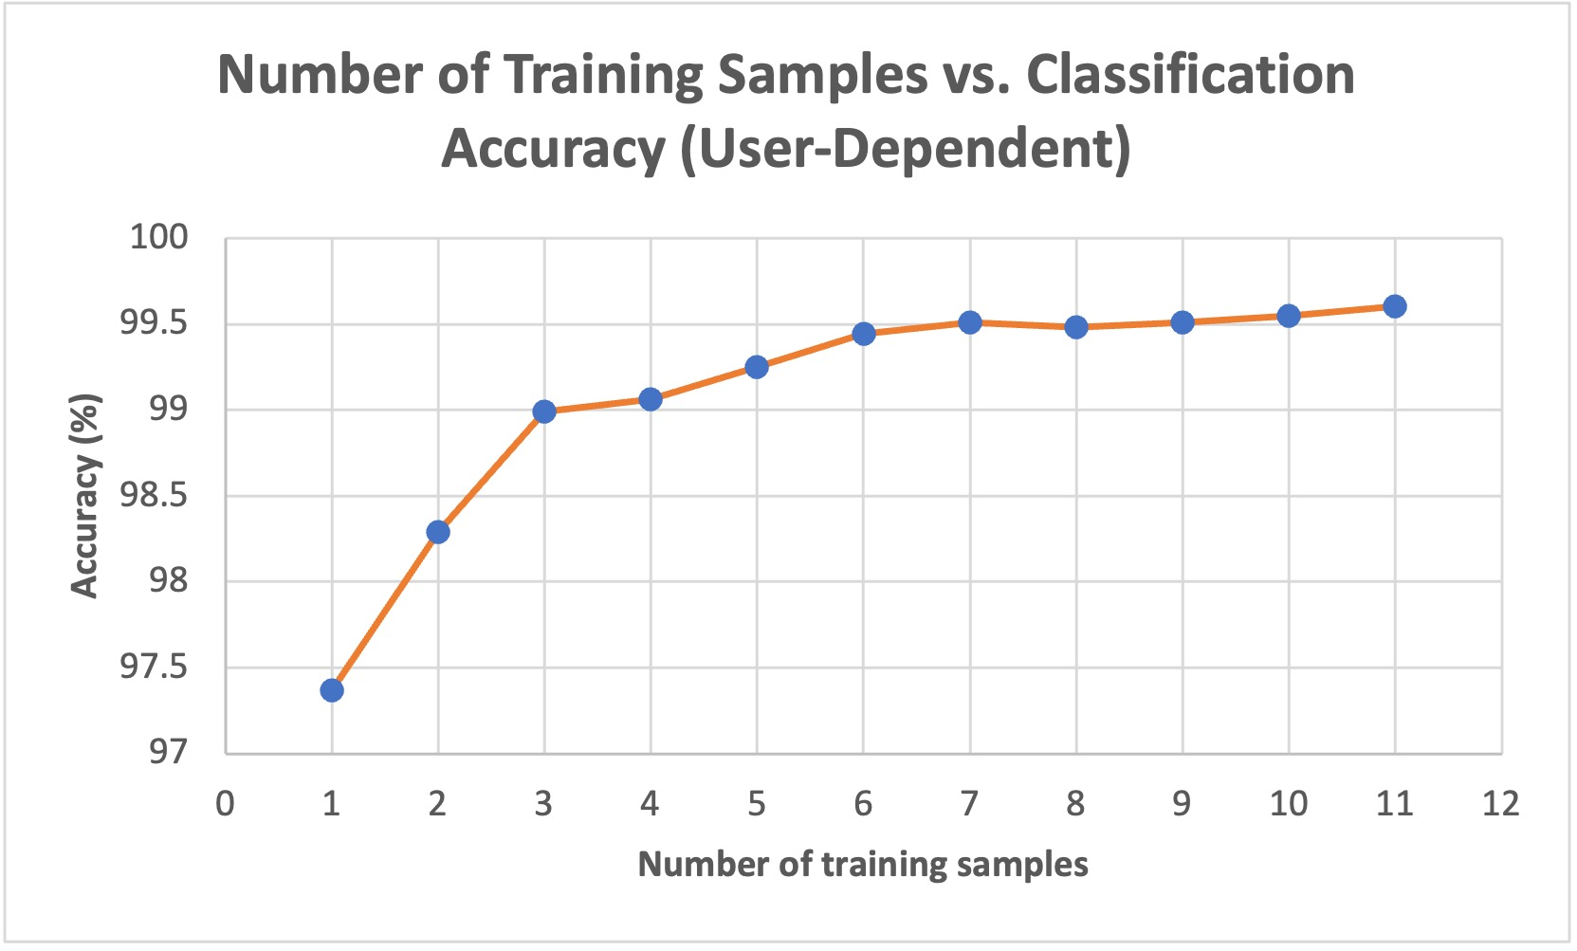
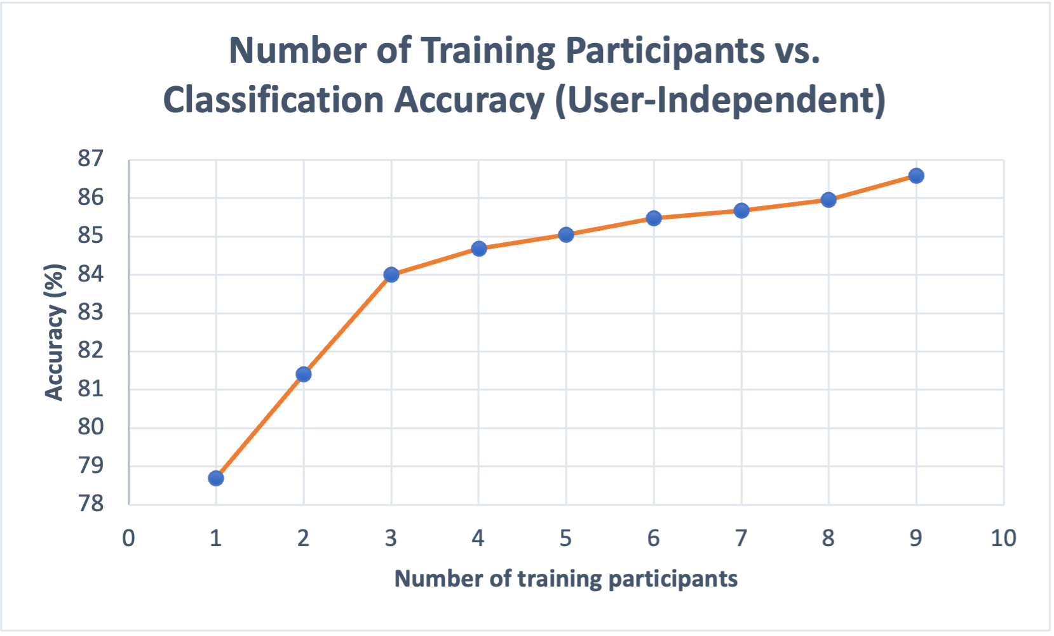
Binary Classification
 | User-Dependent Accuracy | User-Independent Accuracy
Binary Classification (Average) | 99.07% | 85.13%
Binary Classification (Single training template) | 97.37% | 78.69%
Notes:
To understand whether face-touching detection would be feasible on resource-constrained devices, we specifically looked at the case of minimum training templates in both scenarios. We only ran this additional experiment for the binary classification problem since our primary goal for the study was to classify the data samples into one of the two groups.

Slide 25
Binary Classification
 | User-Dependent Accuracy | User-Independent Accuracy
Binary Classification (Average) | 99.07% | 85.13%
Binary Classification (Single training template) | 97.37% | 78.69%
Notes:
In this experiment, we trained with only a single template for each activity type.
In the user-dependent scenario, the accuracy only dropped by 1.7% with this single template constraint.

Slide 26
Binary Classification
 | User-Dependent Accuracy | User-Independent Accuracy
Binary Classification (Average) | 99.07% | 85.13%
Binary Classification (Single training template) | 97.37% | 78.69%
Notes:
And we can see in the figure that the accuracy increased back to the average 99% accuracy with only 3 templates for each activity type

Slide 27
Binary Classification
 | User-Dependent Accuracy | User-Independent Accuracy
Binary Classification (Average) | 99.07% | 85.13%
Binary Classification (Single training template) | 97.37% | 78.69%
A DTW-based classifier has the potential to provide a personalized face-touching detection service on resource-constrained devices such as smartwatches.
Notes:
This result showed that a DTW-based classifier has the potential to provide a personalized face-touching detection service on resource-constrained devices such as smartwatches

Slide 28
Binary Classification
 | User-Dependent Accuracy | User-Independent Accuracy
Binary Classification (Average) | 99.07% | 85.13%
Binary Classification (Single training template) | 97.37% | 78.69%
Notes:
In the user-independent scenario, a single template for each activity type was selected from a single training participant. The classifier only achieved an accuracy of 78.69% with the single template constraint

Slide 29
Binary Classification
 | User-Dependent Accuracy | User-Independent Accuracy
Binary Classification (Average) | 99.07% | 85.13%
Binary Classification (Single training template) | 97.37% | 78.69%
Notes:
Therefore, we increased the number of training participants for each activity. As we can see in the figure, the classifier achieved the average 85% accuracy when the number of training participants was increased to five or more.

Slide 30
Multiclass Classification (User-Dependent)
Predicted Class Actual Class | Mobile Phone | Lying Flat | Computer Tasks | Writing | Leisurely Walk | Moving Items | Repeated Face Touching | Eating and Drinking | Simulated Smoking | Adjusting Eyeglasses
Mobile Phone | 99.09% | 0.00% | 0.55% | 0.00% | 0.00% | 0.00% | 0.00% | 0.00% | 0.36% | 0.00%
Lying Flat | 0.00% | 98.64% | 0.27% | 0.00% | 0.00% | 0.00% | 0.18% | 0.00% | 0.73% | 0.18%
Computer Tasks | 2.00% | 0.00% | 96.45% | 1.45% | 0.00% | 0.09% | 0.00% | 0.00% | 0.00% | 0.00%
Writing | 0.00% | 0.00% | 0.18% | 99.82% | 0.00% | 0.00% | 0.00% | 0.00% | 0.00% | 0.00%
Leisurely Walk | 0.82% | 0.00% | 0.00% | 0.09% | 94.36% | 4.00% | 0.64% | 0.09% | 0.00% | 0.00%
Moving Items | 0.18% | 0.00% | 0.45% | 3.45% | 0.00% | 94.18% | 0.00% | 1.45% | 0.27% | 0.00%
Repeated Face Touching | 0.00% | 0.27% | 0.00% | 0.00% | 0.00% | 0.55% | 83.91% | 3.27% | 3.45% | 8.55%
Eating and Drinking | 0.00% | 0.00% | 0.00% | 0.09% | 0.00% | 1.55% | 2.18% | 90.91% | 2.73% | 2.55%
Simulated Smoking | 0.45% | 0.09% | 0.55% | 0.18% | 0.00% | 0.64% | 2.91% | 1.45% | 89.09% | 4.64%
Adjusting Eyeglasses | 0.18% | 0.55% | 0.00% | 0.00% | 0.00% | 0.09% | 10.91% | 3.45% | 6.45% | 78.36%
Notes:
For multiclass classification, this is the confusion matrix in the user-dependent scenario. Face-touching activities are colored in red. The deep blue elements indicate correct classifications while the light blue elements indicate relatively high rates of confusions.

Slide 31
Multiclass Classification (User-Dependent)
Predicted Class Actual Class | Mobile Phone | Lying Flat | Computer Tasks | Writing | Leisurely Walk | Moving Items | Repeated Face Touching | Eating and Drinking | Simulated Smoking | Adjusting Eyeglasses
Mobile Phone | 99.09% | 0.00% | 0.55% | 0.00% | 0.00% | 0.00% | 0.00% | 0.00% | 0.36% | 0.00%
Lying Flat | 0.00% | 98.64% | 0.27% | 0.00% | 0.00% | 0.00% | 0.18% | 0.00% | 0.73% | 0.18%
Computer Tasks | 2.00% | 0.00% | 96.45% | 1.45% | 0.00% | 0.09% | 0.00% | 0.00% | 0.00% | 0.00%
Writing | 0.00% | 0.00% | 0.18% | 99.82% | 0.00% | 0.00% | 0.00% | 0.00% | 0.00% | 0.00%
Leisurely Walk | 0.82% | 0.00% | 0.00% | 0.09% | 94.36% | 4.00% | 0.64% | 0.09% | 0.00% | 0.00%
Moving Items | 0.18% | 0.00% | 0.45% | 3.45% | 0.00% | 94.18% | 0.00% | 1.45% | 0.27% | 0.00%
Repeated Face Touching | 0.00% | 0.27% | 0.00% | 0.00% | 0.00% | 0.55% | 83.91% | 3.27% | 3.45% | 8.55%
Eating and Drinking | 0.00% | 0.00% | 0.00% | 0.09% | 0.00% | 1.55% | 2.18% | 90.91% | 2.73% | 2.55%
Simulated Smoking | 0.45% | 0.09% | 0.55% | 0.18% | 0.00% | 0.64% | 2.91% | 1.45% | 89.09% | 4.64%
Adjusting Eyeglasses | 0.18% | 0.55% | 0.00% | 0.00% | 0.00% | 0.09% | 10.91% | 3.45% | 6.45% | 78.36%
There were more within-category confusions than between-category confusions.
Notes:
there were more within-category confusions than between-category confusions
This explains the classifier’s better performance in binary classification than in multiclass classification.

Slide 32

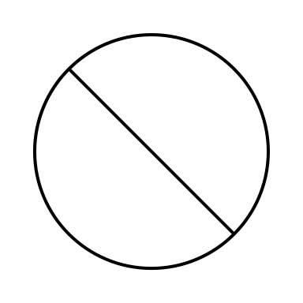
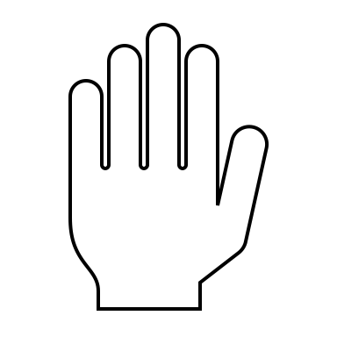
Takeaways
Smartwatches have the potential for achieving our health goal as well as other goals including quitting smoking and treating the hair-pulling disorder.
Notes:
here are the overall take-aways from this work
The first take-away is that smartwatches have the potential for achieving our health goal.
Besides detecting face touching, the findings from our study also indicate a potential use of smartwatches for quitting smoking and treating the hair-pulling disorder.

Slide 33
Takeaways
Smartwatches have the potential for achieving our health goal as well as other goals including quitting smoking and treating the hair-pulling disorder.
Multiclass classification is challenging, while formulating the problem as a binary classification problem significantly increases the recognition accuracy.
Notes:
Next, multiclass classification is challenging, while formulating the problem as a binary classification problem significantly increases the accuracy.

Slide 34
Takeaways
Smartwatches have the potential for achieving our health goal as well as other goals including quitting smoking and treating the hair-pulling disorder.
Multiclass classification is challenging, while formulating the problem as a binary classification problem significantly increases the recognition accuracy.
DTW has the potential to provide a personalized face-touching detection service on resource-constrained devices such as smartwatches.
Notes:
Lastly, given the high accuracy in the user-dependent scenario, a DTW-based classifier has the potential to provide a personalized face-touching detection service on resource-constrained devices such as smartwatches

Slide 35
Limitations and Future Work
Participants wore the smartwatch on their dominant wrist
Data were collected in a laboratory setting
Gyroscope data were not collected
We did not compare the quantitative results of both DTW and ML-based methods
Our classification experiments were conducted offline
Notes:
there are several limitations to the scope of this late-breaking work
First, we asked our participants to wear the smartwatch on their dominant wrist since we included a writing task, but many people prefer wearing watches on their non-dominant hand.
Second, we collected data in a laboratory setting, but users’ behaviors as well as external factors may differ in a real-world setting. Also, we did not collect gyroscope data, which has been shown to increase the classification accuracy.
Next, we did not compare the quantitative results of both DTW and ML-based methods regarding classification accuracy and required resources. It could be beneficial to do so in future studies.
Finally, our classification experiments were only conducted in an offline manner. Future work should implement real-time face-touching detection on smartwatches and study the efficacy in reducing users’ face-touching behaviors.

Slide 36





Thank You!
Contact Authors
Yu-Peng Chen – yupengchen@ufl.edu
Chen Bai – chenbai@ufl.edu
Dr. Lisa Anthony – lanthony@cise.ufl.edu
Yu-Peng Chen
Dr. Lisa Anthony
Chen Bai
Adam Wolach
Dr. Mamoun T. Mardini
Yu-Peng Chen, Chen Bai, Adam Wolach, Mamoun T. Mardini, and Lisa Anthony. 2021. Detecting Face Touching with Dynamic Time Warping on Smartwatches: A Preliminary Study. In Companion Publication of the 2021 International Conference on Multimodal Interaction (ICMI ’21 Companion), October 18–22, 2021, Montréal, QC, Canada. ACM, New York, NY, USA, 8 pages. https://doi.org/10.1145/3461615.3485433
Notes:
with this I wrap up my talk, If you have any questions, feel free to contact us through our email addresses
Thank you for listening to my talk.

