Slide 1
Examining the Link between Children's Cognitive Development and Touchscreen Interaction Patterns
Ziyang Chen¹, Yu-Peng Chen¹, Alex Shaw¹, Aishat Aloba¹,
Pavlo Antonenko², Jaime Ruiz¹, Lisa Anthony¹
¹Dept. of CISE, University of Florida, FL USA
²Sch. of Teaching & Learning, University of Florida, FL USA
Ziyang Chen, Yu-Peng Chen, Alex Shaw, Aishat Aloba, Pavlo Antonenko, Jaime Ruiz, and Lisa Anthony. 2020. Examining the Link between Children's Cognitive Development and Touchscreen Interaction Patterns. In Proceedings of 2020 ACM International Conference on Multimodal Interaction (ICMI ‘20), October 25-29, Virtual event, Netherlands. ACM, New York, NY, USA, 4 pages. https://doi.org/10.1145/3382507.3418841
Notes:
Hi everyone, I‘m Yu-Peng Chen, a...
Today I will be talking about
I did this work along with ...
under the guidance ...
Slide number

Slide 2

Photo by McKaela Lee on Unsplash
Notes:
Children are increasingly exposed to …
and using them in various context
and prior work shows that
children’s touchscreen … are different from adluts
So we conducted studies to inform the design of
interfaces tailored towards chidlrens

Slide 3
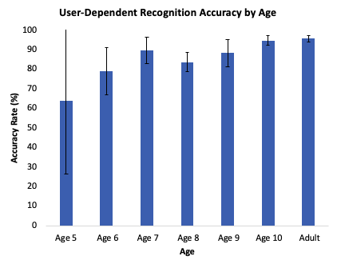
Motivation
Age
  Younger children’s touchscreen interactions differ from those of older children and adults (Woodward et al. CHI 2016)
Cognitive development
  There could be large variations in cognitive development within age groups (Santrock. 2006)
(Woodward et al. CHI 2016)
Notes:
From our prior work,
when simply considering age
Woodward et al. found that younger children had more trouble …
and that their gestures were …
So children’s age obviously is an important factor
However,
Santrock stated in his book that …

Slide 4




Motivation
I’m 5 years old.
Your score is 59
Is age a sufficiently sensitive factor?
Children’s touchscreen interaction and cognitive development
NIH
Your score is 72
I’m 4 years old.
NIH
Cognitive Development Test
Notes:
Therefore,
we wanted to see if a more fine-grained measurement such as …
an understanding of such relationship could be helpful for … for each child

Slide 5
Motivation
I’m 5 years old.
Your score is 59
Is age a sufficiently sensitive factor?
  May be too coarse
Children’s touchscreen interaction and cognitive development
NIH
Your score is 72
I’m 4 years old.
NIH
Cognitive Development Test
Notes:
Therefore,
we wanted to see if a more fine-grained measurement such as …
an understanding of such relationship could be helpful for … for each child

Slide 6
Research Question
Are fine-grained measurements from cognitive assessments sufficiently approximated by age for touchscreen tasks from our previous work?
Notes:
That leads to our research question, which is …
we use tasks like those in prior work on touchscreen interactions to allow for direct comparison
and we also extended them to a younger age, which is 4-year-old

Slide 7

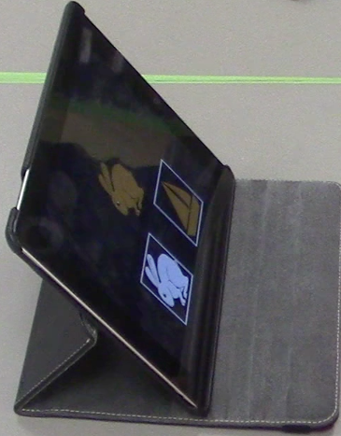
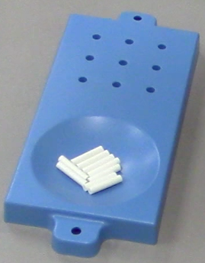
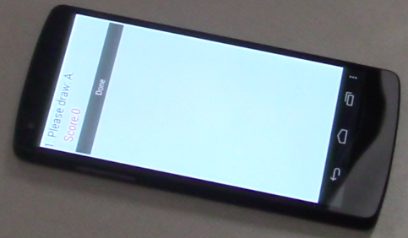
Method
Cognitive assessments: NIH Toolbox®
Touchscreen target and gesture tasks (Anthony et al. ITS 2012)
https://www.healthmeasures.net/explore-measurement-systems/nih-toolbox
iPad
Pegboard and pegs
Smartphone

Slide 8
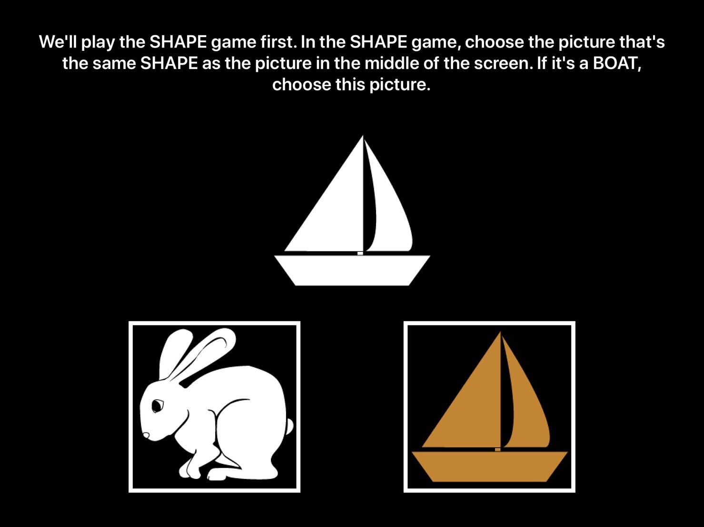
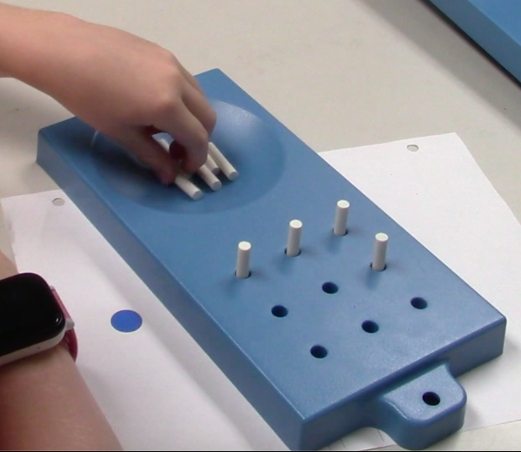
NIH Toolbox® Tests
The 9-hole Pegboard Dexterity Test
  Fine motor skill
The Dimensional Change Card Sort Test
  Executive function¹
¹ NIH defines executive function as “the capacity to plan, organize, and monitor the execution of behaviors that are strategically directed in a goal-oriented manner.”
Notes:
And then for cognitive development measurements,
we added the executive function and fine motor skill measurements from the NIH toolbox
The toolbox is used …
and we chose
… for measuring …
… for measuring …

Slide 9
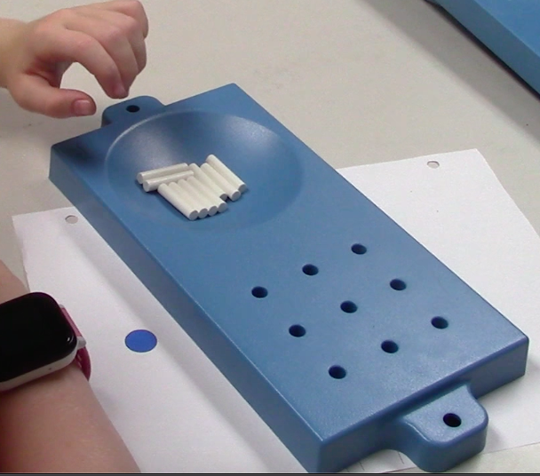
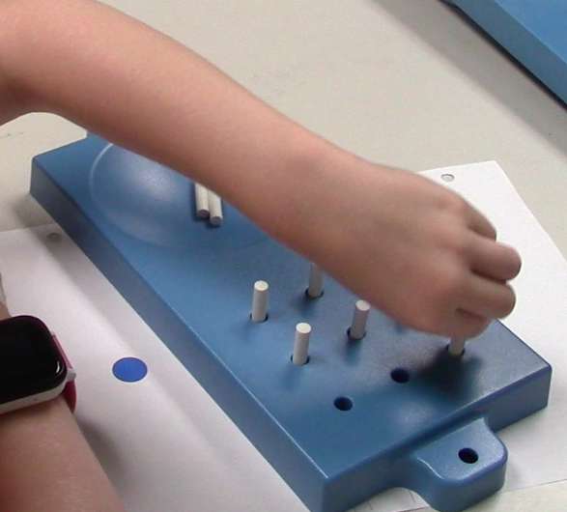
9-hole Pegboard Dexterity Test
Measuring fine motor skill
Notes:
In the test, participants are asked to place 9 pegs into a board of 9 holes (Figure 1), and then remove them as quickly as possible.
Experimenters record the amount of time taken for the participant to complete the task.
In our study, each participant completed the task twice with each hand, with the first attempt for each hand being a practice run
extra pegs
practice round
pIU526

Slide 10
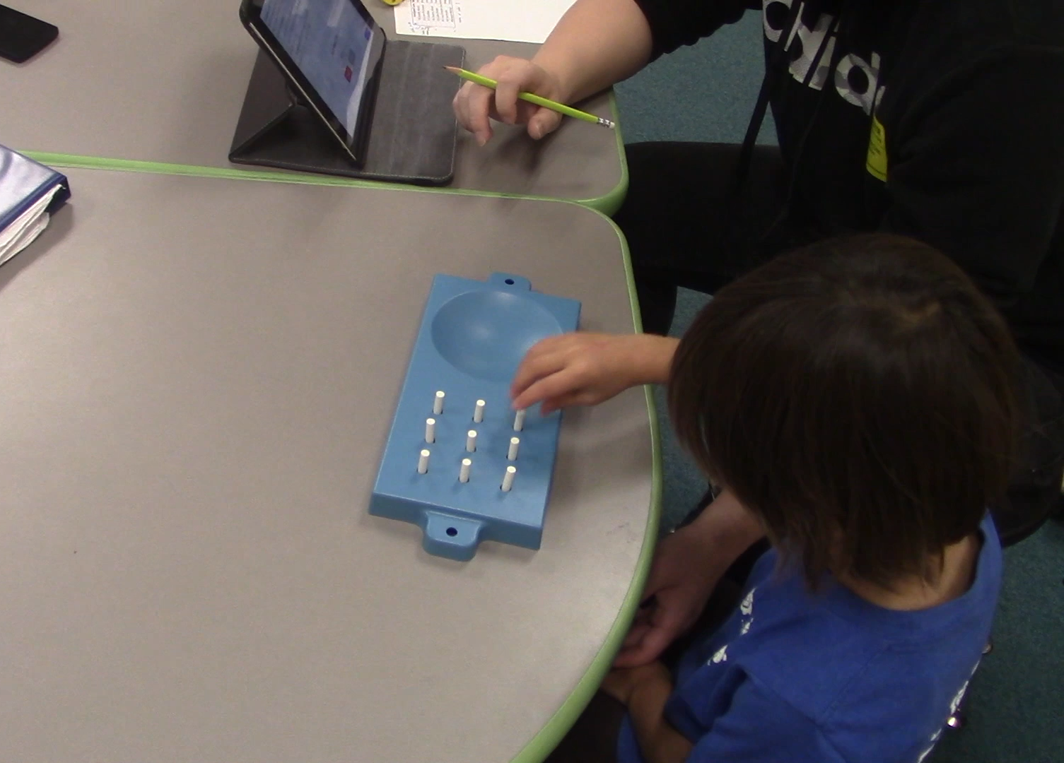
9-hole Pegboard Dexterity Test
Notes:
IU526
children have to use only one hand at a time
so sometimes we had to hold their other hand
we also remind them to take the pegs out

Slide 11
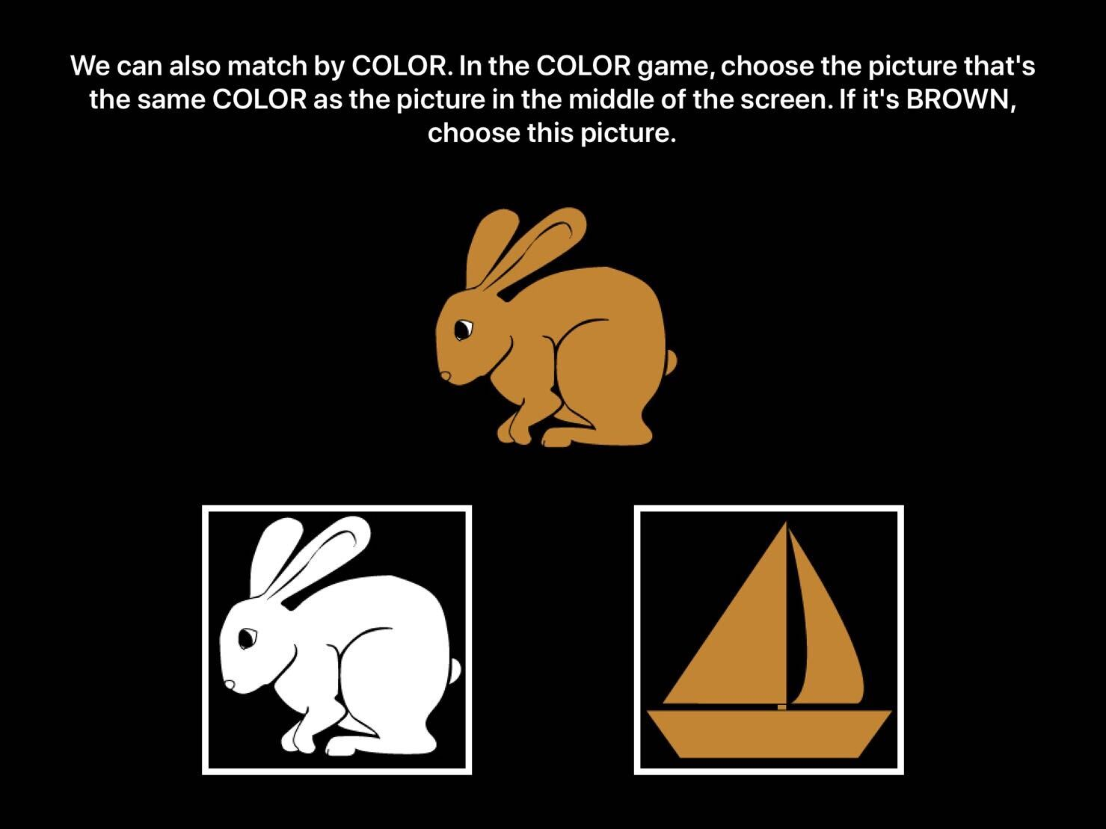
Dimensional Change Card Sort Test
Measuring executive function
SHAPE game
COLOR game
Notes:
In the test, the participant is shown a series of two images and asked to select one that matches either a given color or a given shape

Slide 12

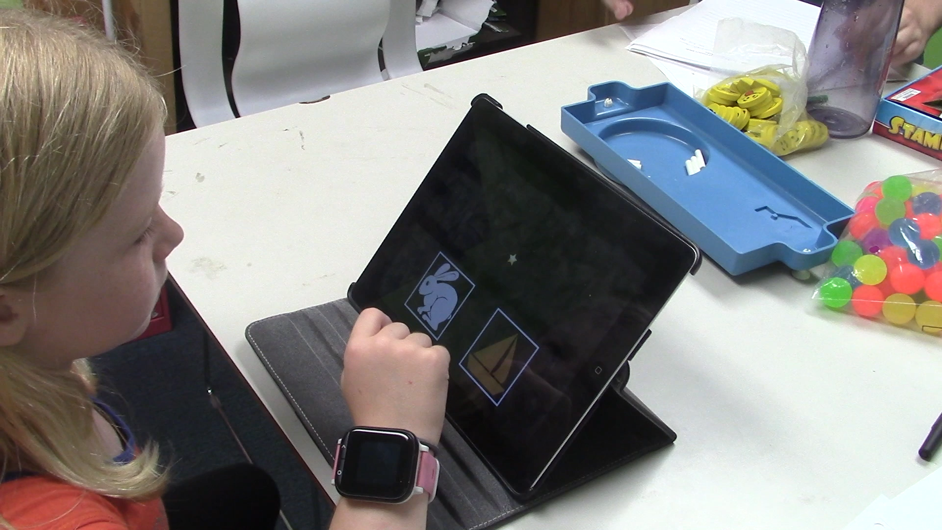
Dimensional Change Card Sort Test
Notes:
pIU352

Slide 13
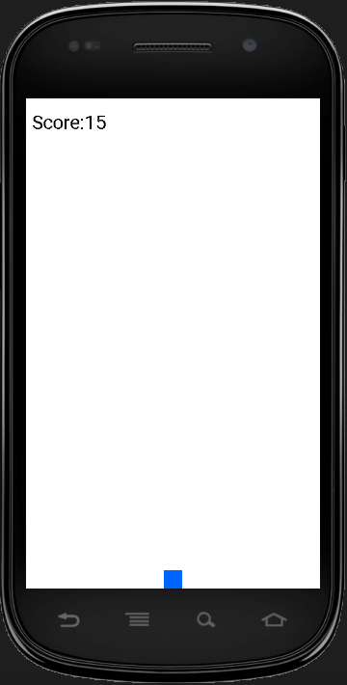
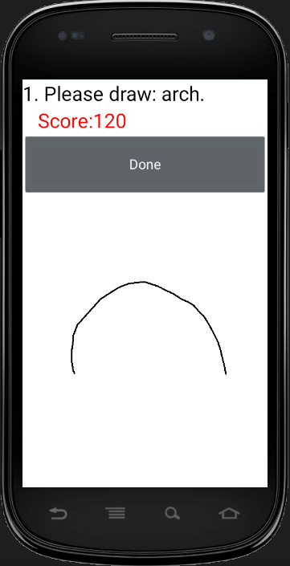
Study Design
1st phase
2nd phase
The 9-hole Pegboard Dexterity Test
The Dimensional Change Card Sort Test
Target touching task
Gesture drawing task
counterbalanced
counterbalanced
Notes:
The order of the tasks within each phase was counterbalanced

Slide 14
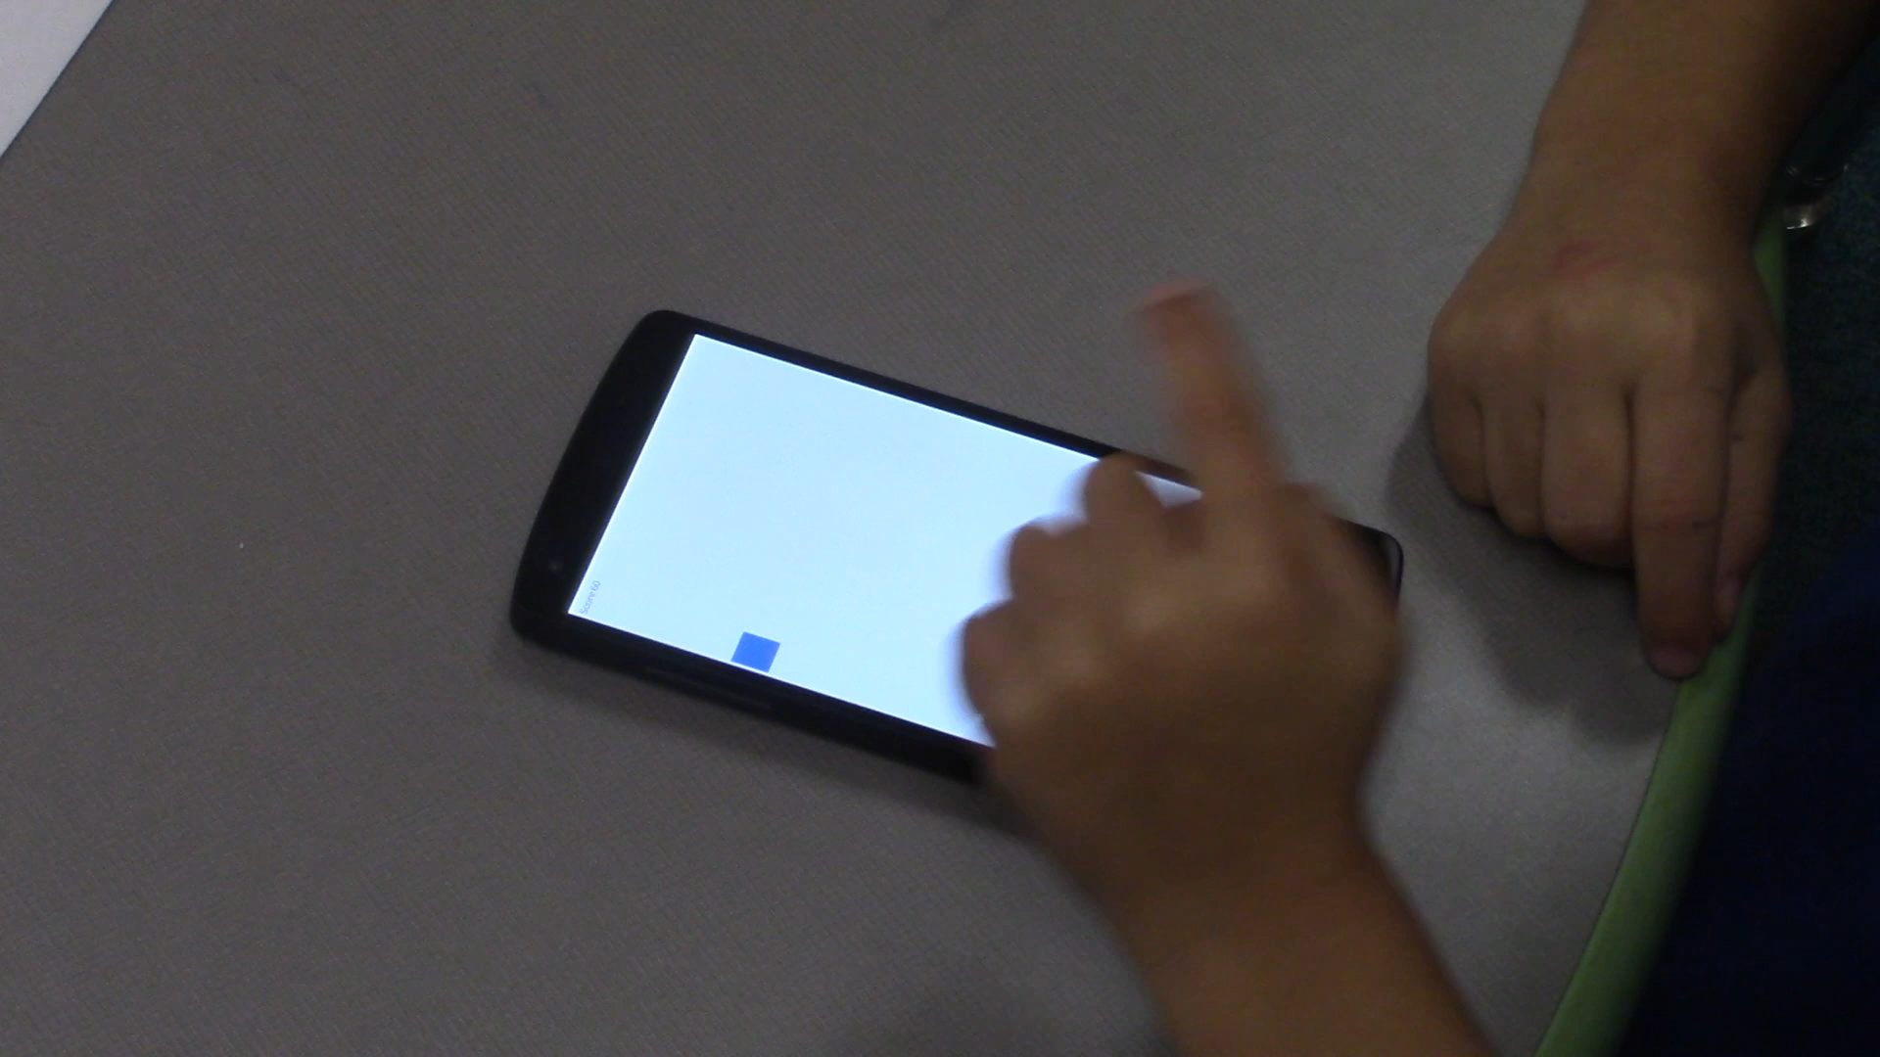
Target Touching Task
Per-user target miss rate
(Anthony et al. ITS 2012)

Slide 15
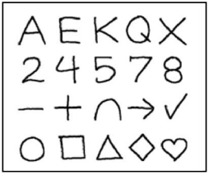
Gesture Drawing Task
Gesture set
(Anthony et al. ITS 2012)
User-dependent recognition rate
  $P recognizer
  (Vatavu et al. ICMI 2012)

Slide 16
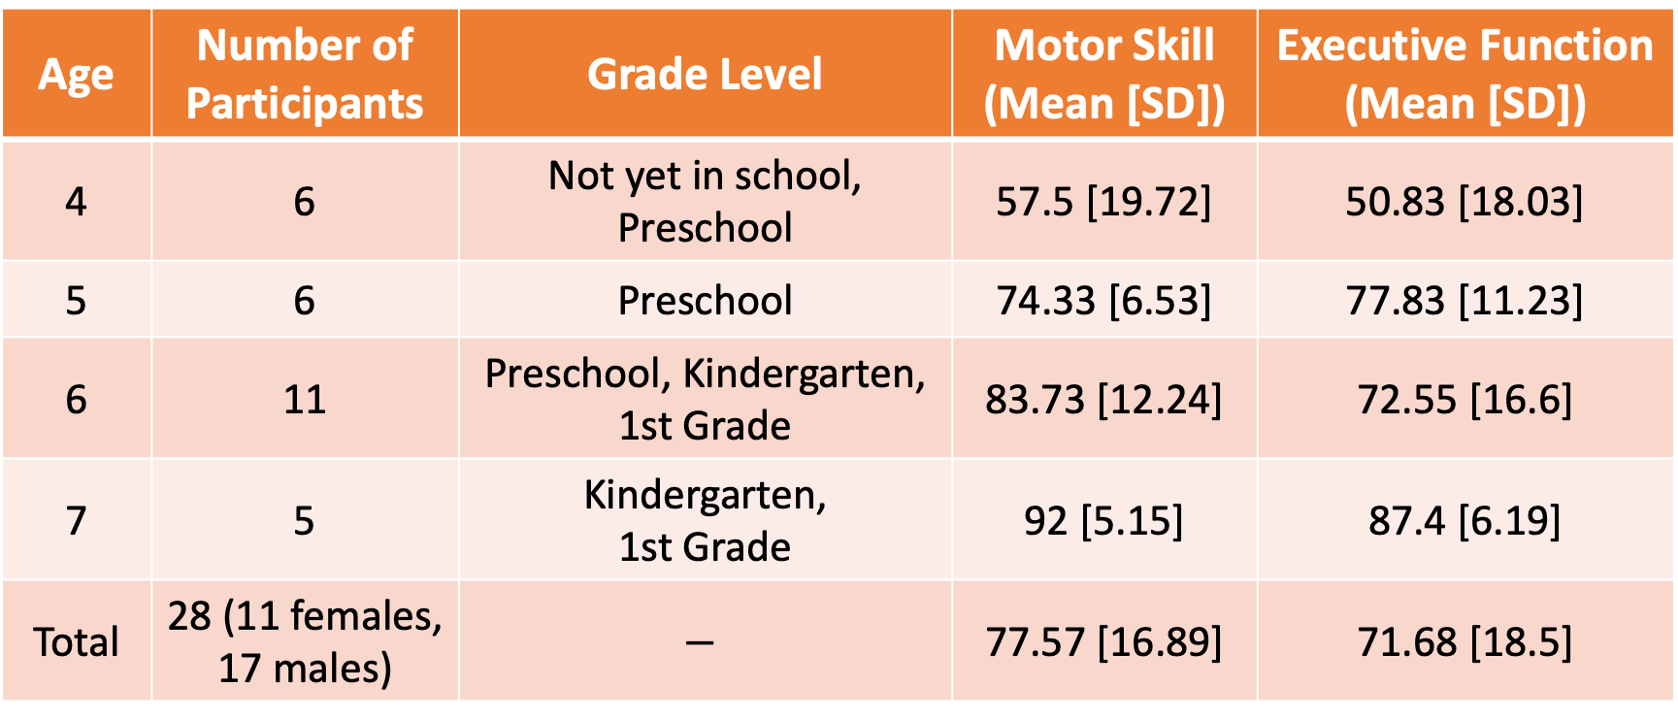
Participants
Age | Number of Participants | Grade Level | Motor Skill (Mean [SD]) | Executive Function (Mean [SD])
4 | 6 | Not yet in school, Preschool | 57.5 [19.72] | 50.83 [18.03]
5 | 6 | Preschool | 74.33 [6.53] | 77.83 [11.23]
6 | 11 | Preschool, Kindergarten, 1st Grade | 83.73 [12.24] | 72.55 [16.6]
7 | 5 | Kindergarten, 1st Grade | 92 [5.15] | 87.4 [6.19]
Total | 28 (11 females, 17 males) | $$−$$ | 77.57 [16.89] | 71.68 [18.5]

Slide 17
Participants
Age | Number of Participants | Grade Level | Motor Skill (Mean [SD]) | Executive Function (Mean [SD])
4 | 6 | Not yet in school, Preschool | 57.5 [19.72] | 50.83 [18.03]
5 | 6 | Preschool | 74.33 [6.53] | 77.83 [11.23]
6 | 11 | Preschool, Kindergarten, 1st Grade | 83.73 [12.24] | 72.55 [16.6]
7 | 5 | Kindergarten, 1st Grade | 92 [5.15] | 87.4 [6.19]
Total | 28 (11 females, 17 males) | $$−$$ | 77.57 [16.89] | 71.68 [18.5]

Slide 18
Participants
Age | Number of Participants | Grade Level | Motor Skill (Mean [SD]) | Executive Function (Mean [SD])
4 | 6 | Not yet in school, Preschool | 57.5 [19.72] | 50.83 [18.03]
5 | 6 | Preschool | 74.33 [6.53] | 77.83 [11.23]
6 | 11 | Preschool, Kindergarten, 1st Grade | 83.73 [12.24] | 72.55 [16.6]
7 | 5 | Kindergarten, 1st Grade | 92 [5.15] | 87.4 [6.19]
Total | 28 (11 females, 17 males) | $$−$$ | 77.57 [16.89] | 71.68 [18.5]

Slide 19
Participants
Age | Number of Participants | Grade Level | Motor Skill (Mean [SD]) | Executive Function (Mean [SD])
4 | 6 | Not yet in school, Preschool | 57.5 [19.72] | 50.83 [18.03]
5 | 6 | Preschool | 74.33 [6.53] | 77.83 [11.23]
6 | 11 | Preschool, Kindergarten, 1st Grade | 83.73 [12.24] | 72.55 [16.6]
7 | 5 | Kindergarten, 1st Grade | 92 [5.15] | 87.4 [6.19]
Total | 28 (11 females, 17 males) | $$−$$ | 77.57 [16.89] | 71.68 [18.5]

Slide 20
Participants
Age | Number of Participants | Grade Level | Motor Skill (Mean [SD]) | Executive Function (Mean [SD])
4 | 6 | Not yet in school, Preschool | 57.5 [19.72] | 50.83 [18.03]
5 | 6 | Preschool | 74.33 [6.53] | 77.83 [11.23]
6 | 11 | Preschool, Kindergarten, 1st Grade | 83.73 [12.24] | 72.55 [16.6]
7 | 5 | Kindergarten, 1st Grade | 92 [5.15] | 87.4 [6.19]
Total | 28 (11 females, 17 males) | $$−$$ | 77.57 [16.89] | 71.68 [18.5]

Slide 21
Findings
All 4 factors (age, grade level, motor skill, executive function) show significant but moderate negative correlations with target miss rate
All 4 factors (age, grade level, motor skill, executive function) show significant but moderate positive correlations with gesture recognition rate

Slide 22
Findings
All 4 factors (age, grade level, motor skill, executive function) show significant but moderate negative correlations with target miss rate
All 4 factors (age, grade level, motor skill, executive function) show significant but moderate positive correlations with gesture recognition rate

Slide 23
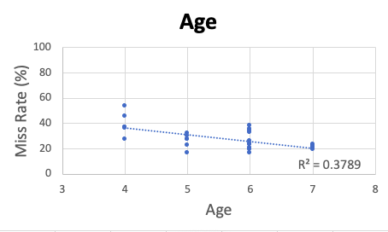
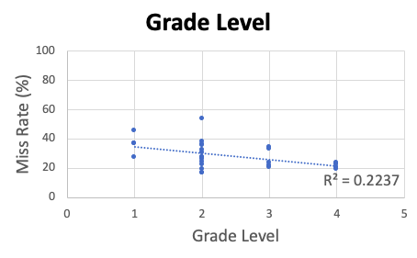
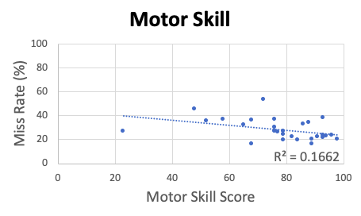
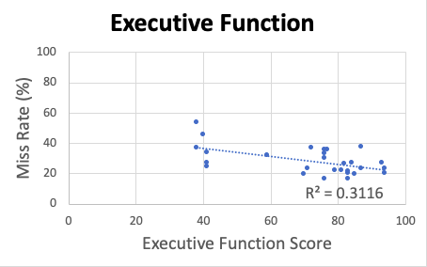
Target Miss Rate
R(26) = -0.62, p < 0.05
R(26) = -0.47, p < 0.05
1: Not yet in school
2: Preschool
3: Kindergarten
4: 1st Grade
R(26) = -0.41, p < 0.05
R(26) = -0.56, p < 0.05
All 4 factors show significant but moderate negative correlations
Notes:
Between all four factors and target miss rate
interpretation
moderate?
How do we calculate the score
Gesture Analysis
Dependent accuracy
Independent accuracy
Target touching
Miss rate, which is the proportion of a user’s misses over all targets
(holdover is defined as a touch in the previous target location)
as in previous work
(Holdover, locations, target size)
All correlations have a similar strength and would be considered moderate in the context of human-subjects research
Based on Dancey’s book statistics without maths for psychology

Slide 24
Target Miss Rate
R(26) = -0.62, p < 0.05
R(26) = -0.47, p < 0.05
1: Not yet in school
2: Preschool
3: Kindergarten
4: 1st Grade
R(26) = -0.41, p < 0.05
R(26) = -0.56, p < 0.05
All 4 factors show significant but moderate negative correlations
Notes:
Between all four factors and target miss rate
interpretation
moderate?
How do we calculate the score
Gesture Analysis
Dependent accuracy
Independent accuracy
Target touching
Miss rate, which is the proportion of a user’s misses over all targets
(holdover is defined as a touch in the previous target location)
as in previous work
(Holdover, locations, target size)
All correlations have a similar strength and would be considered moderate in the context of human-subjects research
Based on Dancey’s book statistics without maths for psychology

Slide 25
Target Miss Rate
R(26) = -0.62, p < 0.05
R(26) = -0.47, p < 0.05
1: Not yet in school
2: Preschool
3: Kindergarten
4: 1st Grade
R(26) = -0.41, p < 0.05
R(26) = -0.56, p < 0.05
All 4 factors show significant but moderate negative correlations
Notes:
Between all four factors and target miss rate
interpretation
moderate?
How do we calculate the score
Gesture Analysis
Dependent accuracy
Independent accuracy
Target touching
Miss rate, which is the proportion of a user’s misses over all targets
(holdover is defined as a touch in the previous target location)
as in previous work
(Holdover, locations, target size)
All correlations have a similar strength and would be considered moderate in the context of human-subjects research
Based on Dancey’s book statistics without maths for psychology

Slide 26
Target Miss Rate
Take-away: using Motor Skill and Executive Function does not provide additional nuances beyond simply looking at age or grade level for target touching task
Notes:
Between all four factors and target miss rate
interpretation
moderate?
How do we calculate the score
Gesture Analysis
Dependent accuracy
Independent accuracy
Target touching
Miss rate, which is the proportion of a user’s misses over all targets
(holdover is defined as a touch in the previous target location)
as in previous work
(Holdover, locations, target size)
All correlations have a similar strength and would be considered moderate in the context of human-subjects research
Based on Dancey’s book statistics without maths for psychology

Slide 27
Findings
All 4 factors (age, grade level, motor skill, executive function) show significant but moderate negative correlations with target miss rate
All 4 factors (age, grade level, motor skill, executive function) show significant but moderate positive correlations with gesture recognition rate

Slide 28
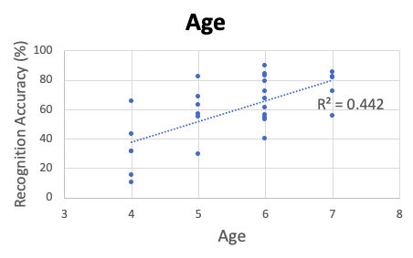
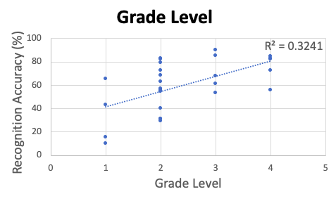
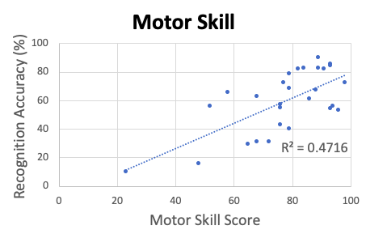
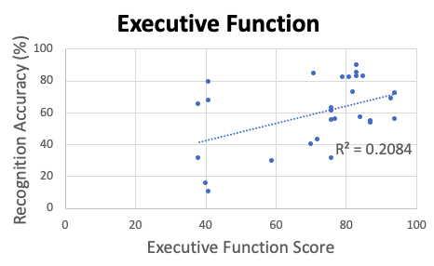
User-Dependent Recognition Rate
R(26) = 0.66, p < 0.05
R(26) = 0.57, p < 0.05
1: Not yet in school
2: Preschool
3: Kindergarten
4: 1st Grade
R(26) = 0.69, p < 0.05
R(26) = 0.46, p < 0.05
All 4 factors show significant but moderate positive correlations
Notes:
Between all four factors and target miss rate
interpretation
moderate?
How do we calculate the score
Gesture Analysis
Dependent accuracy
Independent accuracy
Target touching
Miss rate, which is the proportion of a user’s misses over all targets
(holdover is defined as a touch in the previous target location)
as in previous work
(Holdover, locations, target size)
All correlations have a similar strength and would be considered moderate in the context of human-subjects research
Based on Dancey’s book statistics without maths for psychology

Slide 29
User-Dependent Recognition Rate
R(26) = 0.66, p < 0.05
R(26) = 0.57, p < 0.05
1: Not yet in school
2: Preschool
3: Kindergarten
4: 1st Grade
R(26) = 0.69, p < 0.05
R(26) = 0.46, p < 0.05
All 4 factors show significant but moderate positive correlations
Notes:
Between all four factors and target miss rate
interpretation
moderate?
How do we calculate the score
Gesture Analysis
Dependent accuracy
Independent accuracy
Target touching
Miss rate, which is the proportion of a user’s misses over all targets
(holdover is defined as a touch in the previous target location)
as in previous work
(Holdover, locations, target size)
All correlations have a similar strength and would be considered moderate in the context of human-subjects research
Based on Dancey’s book statistics without maths for psychology

Slide 30
User-Dependent Recognition Rate
R(26) = 0.66, p < 0.05
R(26) = 0.57, p < 0.05
1: Not yet in school
2: Preschool
3: Kindergarten
4: 1st Grade
R(26) = 0.69, p < 0.05
R(26) = 0.46, p < 0.05
All 4 factors show significant but moderate positive correlations
Notes:
Between all four factors and target miss rate
interpretation
moderate?
How do we calculate the score
Gesture Analysis
Dependent accuracy
Independent accuracy
Target touching
Miss rate, which is the proportion of a user’s misses over all targets
(holdover is defined as a touch in the previous target location)
as in previous work
(Holdover, locations, target size)
All correlations have a similar strength and would be considered moderate in the context of human-subjects research
Based on Dancey’s book statistics without maths for psychology

Slide 31
User-Dependent Recognition Rate
Take-away: using Motor Skill and Executive Function does not provide additional nuances beyond simply looking at age or grade level for gesture drawing task
Notes:
Between all four factors and target miss rate
interpretation
moderate?
How do we calculate the score
Gesture Analysis
Dependent accuracy
Independent accuracy
Target touching
Miss rate, which is the proportion of a user’s misses over all targets
(holdover is defined as a touch in the previous target location)
as in previous work
(Holdover, locations, target size)
All correlations have a similar strength and would be considered moderate in the context of human-subjects research
Based on Dancey’s book statistics without maths for psychology

Slide 32


Main Take-Away
Children’s age or grade level is sufficiently sensitive when considering their touchscreen interactions
Age
Grade Level
$$\sim$$
Cognitive Development Measurements
Demographic Questionnaire
Notes:
Assessments of cognitive development are relatively expensive and time consuming
Bullets: too formal
Combine into one
clipboard
using motor skill and executive function does not provide much additional nuance
, especially given the additional overhead incurred by measuring children’s cognitive development

Slide 33





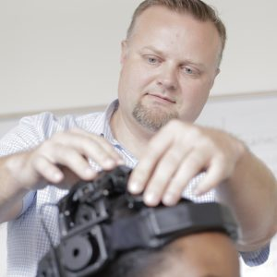

Thank You!
Contact Authors
Yu-Peng Chen – yupengchen@ufl.edu
Alex Shaw – alexshaw@ufl.edu
Dr. Lisa Anthony – lanthony@cise.ufl.edu
Ziyang Chen
Dr. Lisa Anthony
Yu-Peng Chen
Alex Shaw
Aishat Aloba
Dr. Pavlo Antonenko
Dr. Jaime Ruiz
Ziyang Chen, Yu-Peng Chen, Alex Shaw, Aishat Aloba, Pavlo Antonenko, Jaime Ruiz, and Lisa Anthony. 2020. Examining the Link between Children's Cognitive Development and Touchscreen Interaction Patterns. In Proceedings of 2020 ACM International Conference on Multimodal Interaction (ICMI ‘20), October 25-29, Virtual event, Netherlands. ACM, New York, NY, USA, 4 pages. https://doi.org/10.1145/3382507.3418841

